Slide 1
Lecture 4: BA at the Analytical Level (part 1)
Prof. Mike Boyle
Department of Operations and Information Systems
University of Utah

Slide 2
BA at the Analytical Level
Goals:
Inform individuals and groups across the company what data, information and knowledge are possible/expected from their analysis competency (recall “3 pillars”)
Provide data and knowledge
Facilitate process of automating the delivery of information

Slide 3

BA at the Analytical Level
“There are known knowns; there are things we know that we know. There are known unknowns; that is to say, there are things that we now know we don't know. But there are also unknown unknowns – there are things we do not know we don't know.” – United States Secretary of Defense, Donald Rumsfeld
Opportunities created by the BA function are relatively abundant in the areas of:
known unknowns
unknown unknowns

Slide 4
Data, Information and Knowledge
Data: “…carrier of information…”
E.g. “bread” or “10.95”
Rarely provides value to the user in this format

Slide 5
Data, Information and Knowledge
Information: “…data aggregated to a level where it makes sense for decision support…”
E.g. sales of bread for the last three months are $10,000, $15,000 and $21,000 respectively
Delivered by Data Manager or Report Developer in the form of a report, list or table (synonymous)
Reports can be automated
No analysis performed in the process of generating a report
Provides some value to the user due to data being in context

Slide 6
Data, Information and Knowledge
Knowledge: “…information that has been analyzed and interpreted…”
Explanation(s) as to why we’re seeing changes in the sales of bread
E.g. Increase in sales of bread is partly due to a seasonal trend and partly due to a recent change in organization’s marketing processes
Delivered by Analyst in a suitable presentation format (e.g. email, word document, powerpoint, etc.)
Cannot be automated
Data are summarized (e.g. aggregated, filtered, etc.)

Slide 7
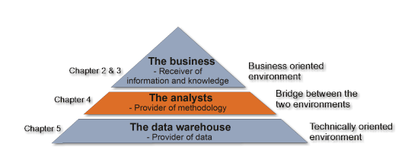
Analyst Role in the BAM

Slide 8

BA at the Analytical Level: Key Roles
Senior Manager
Operational Decision-maker
Analyst
Data Manager/Report Developer
ETL Developer/BI Developer
Database Specialist
IT Professional (various roles)
Request data, information and/or knowledge (variable request quality)
Request data (high request quality); Provide knowledge
Provide data and information
Provide systems that manage data and information delivery

Slide 9
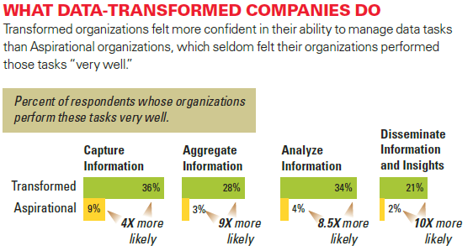
BA at the Analytical Level: What Analytical Companies are Doing
Image Source: LaValle et al, “Big Data, Analytics and the Path From Insights to Value” MIT Sloan Management Review (2011)

Slide 10

Common Pitfall in BA: Process Perspective vs. Systems Perspective
Recall the Business Perspective:
An organization is viewed as a set of coordinated value-adding processes that ultimately create value for customers
A common IT Perspective (explicit or implicit):
“…a number of technologies that constitute a systems structure, in relation to which source data moves.”
There is likely to be conflict with these two common perspectives

Slide 11

Common Pitfall in BA: Process Perspective vs. Systems Perspective (cont’d)
Information Strategy is used to make sure the Process Perspective and the Systems Perspective are aligned

Slide 12
Ingredients for an Effective Analyst
Understanding reporting vs. analysis
Individual analyst attributes
Analytical environment
Common analytical methodologies, tools and techniques

Slide 13
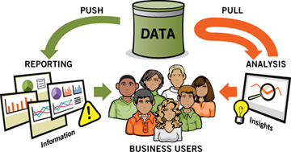
Ingredients (cont’d): Reporting vs. Analysis
Understand and be able to communicate the differences between reporting and analysis
* Image source: Dykes, “Web Analytics Action Hero” Adobe Press (2012)

Slide 14
Ingredients (cont’d): Reporting vs. Analysis
 | Purpose | Tasks | Outputs | Delivery | Value
Reporting | Monitor and Alert | Build Configure Consolidate Organize Format Summarize | Standard reports Dashboards Alerts | Accessed via tool Scheduled for delivery | Distills data into information for further analysis Alerts company to exceptions in data
Analysis | Interpret and recommend actions | Question Examine Interpret Compare Confirm | Ad hoc responses Analysis presentations | Prepared and shared by analyst | Provides deeper insights into biz Offers recommendations to drive action
Source: Dykes, “Web Analytics Action Hero” Adobe Press (2012)

Slide 15
Ingredients for an Effective Analyst
Understanding reporting vs. analysis
Individual analyst attributes
Analytical environment
Common analytical methodologies, tools and techniques

Slide 16
Ingredients (cont’d): Analyst Attributes
Individual analyst attributes
Business understanding
Analytical skills
People skills
Presentation/Influence skills
Analytics industry understanding

Slide 17
Ingredients (cont’d): Analyst Attributes
Business understanding
Business as a set of value-adding processes
Understand the primary value-adding process for the organization
Which processes are used by each department use to achieve their objectives?
Business direction:
What are the mission and the vision?
What is the business strategy?
What are the business objectives and related initiatives in the short term?
Competitors:
Understand the competitive landscape
Customers:
Who are our [good|bad] customers?
Where/How do we acquire new customers?
How do we retain customers?

Slide 18
Ingredients (cont’d): Analyst Attributes
Analytical skills
Intelligent
Detail-oriented
Curious
Open-minded
Objective
Ethical
Systematic in analytical approach
Expert in general analytics tools
Efficient and creative with
sources and uses of data
methodologies

Slide 19
Ingredients (cont’d): Analyst Attributes
People skills
Self-aware
Sociable and likeable
Empathetic to teams and individuals
Visible day to day
Active listening and note-taking
Design and ask calculated questions
Respectful of peoples’ time
Consciously build trust with stakeholders

Slide 20
Ingredients (cont’d): Analyst Attributes
Presentation/Influence skills
Transform details into simple concepts
Data (information) visualization
Ability to align presentation with audience strengths
Align interpretation of analysis with business strategy, objectives, initiatives and/or tactics
Understanding cognitive biases and how to communicate effectively considering the same
Ability to influence action through effective communication and follow-up

Slide 21
Ingredients (cont’d): Analyst Attributes
Analytics industry understanding
Current analytics tools and techniques
Analytics-related conferences and thought-leaders
Analytics career development
Certifications
Recruiting
Best practitioner organizations
Best vendor organizations

Slide 22
Ingredients (cont’d): Analyst Attributes
Discussion: Of the individual analyst attributes:
Which can be developed?
Which cannot be developed? Can any of these be augmented?

Slide 23
Ingredients (cont’d): Analyst Attributes – Analyst Competency Assessment Framework
Area | Description | Score teachables (1 – 5) | Score unteachables (1 – 5)
Business and domain knowledge | E.g. understand eCommerce (business) and Marketing (domain) role therein; understand objectives, strategy and competitive landscape of the biz;
Analysis and data | Intelligent; detail-oriented; curious; open-minded; objective; ethical; systematic in analytical approach; expert in analytics tools; efficient and creative with sources and uses of data
People skills | Self-aware; sociable and likeable; empathetic; visible day to day; active listener; design and ask calculated questions; respectful of peoples’ time; proactively build trust with stakeholders
Presentation and influence skills | Transform details into simple concepts; information visualization; audience-aware, business-aligned presentation material; understand cognitive biases and present accordingly; influence action through effective communication and follow-up
Analytics industry awareness | Current analytics approaches; conferences; luminaries; leading companies; certifications

Slide 24
Ingredients for an Effective Analyst
Understanding reporting vs. analysis
Individual analyst attributes
Analytical environment
Common analytical methodologies, tools and techniques

Slide 25
Ingredients (cont’d): Analytical Environment (Data-Driven Culture)
Analytical Environment
Concept: Without a supportive analytical environment even the best analysts will not thrive
Businesses should consider investing in analysis talent in relation to the current analytical environment
Researchers have found that having management support for analytics throughout the organization including top-down mandates for analytics to be a critical cultural characteristic in organizations that are most successful with analytics*
* Source: Kiron, DAVID, and Rebecca Shockley. "Creating business value with analytics." MIT, Reprint 53112 (2011): 57-63.

Slide 26
Ingredients for an Effective Analyst
Understanding reporting vs. analysis
Individual analyst attributes
Analytical environment
Common analytical methodologies, tools and techniques

Slide 27
Ingredients (cont’d): Analytical Methodologies, Techniques and Tools
To be continued…

Slide 28
Appendix

